Slide 1
CSC6032 – Advanced Operating Systems
Prof. Yeh-Ching Chung
School of Data Science
Chinese University of Hong Kong, Shenzhen

Slide 2
Agenda
Isomorphism
Emulation
Virtualization
Full-virtualization and Para-virtualization
Categories of virtual machine

Slide 3
Isomorphism

Slide 4
Virtualization is an isomorphism
e(Si)
Sj
Si
State mapping
Guest
V(Si)
V(Sj)
Si’
e’(Si’)
Sj’
Emulation
Host

Slide 5
Virtual Machine
A virtual machine (VM) is a software implementation of a machine (i.e. a computer) that executes programs like a physical machine, i.e., add Virtualizing Software to a Host platform and support Guest process or system

Slide 6
OS VMs: Key Issue – ISA Virtualizability
What if privileged instruction no-ops in user mode? (rather than trapping)
Then… VMM can’t intercept when Guest OS attempts the privileged instruction
What if user can access memory with real address?
Then… a guest OS may see that the real memory it really has is different from the memory it thinks it has
What if user can read system control registers?
Then… guest OS may not read the same state value that it thinks it wrote

Slide 7
Virtual Machine Monitor (1)
Virtual Machine Monitor (VMM), a.k.a. Hypervisor, is a virtualizing software to manage hardware resource and arrange resource sharing among different Guest OS.
The role of VMM to Guest OS in a virtualized environment is similar to the role of OS to user space programs in a non-virtualized environment.

Slide 8
Virtual Machine Monitor (2)
Essential VMM characteristics
Identical
Provide an environment essentially identical to the real machine
With the possible exception of differences caused by timing dependency and availability of resources
Efficiency
Programs show only minor decreases in speed
Mostly native instruction execution
Control
Fully control of system resources

Slide 9
Emulation

Slide 10
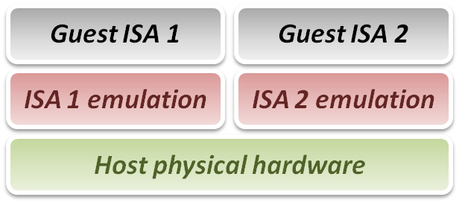
Emulation Technique (1)
Why do we talk about emulation
In fact, virtualization technique can be treated as a special case of emulation technique
Many virtualization techniques were developed in or inherited from emulation technique
Goal of emulation
Provide a method for enabling a (sub)system to present the same interface and characteristics as another

Slide 11
Emulation Technique (2)
Three emulation implementations
Interpretation
Emulator interprets only one instruction at a time
Static Binary Translation
Emulator translates a block of guest binary at a time and further optimizes for repeated instruction executions.\
Dynamic Binary Translation
This is a hybrid approach of emulator, which mix two approaches above.
Design challenges and issues :
Register mapping problem
Performance improvement

Slide 12
Interpretation (1)
Interpreter execution flow
Fetch one guest instruction from guest memory image.
Decode and dispatch to corresponding emulation unit.
Execute the functionality of that instruction and modify some related system states, such as simulated register values.
Increase the guest PC (Program Counter register) and then repeat this process again.
Pros & Cons
Pros
Easy to implement
Cons
Poor performance

Slide 13
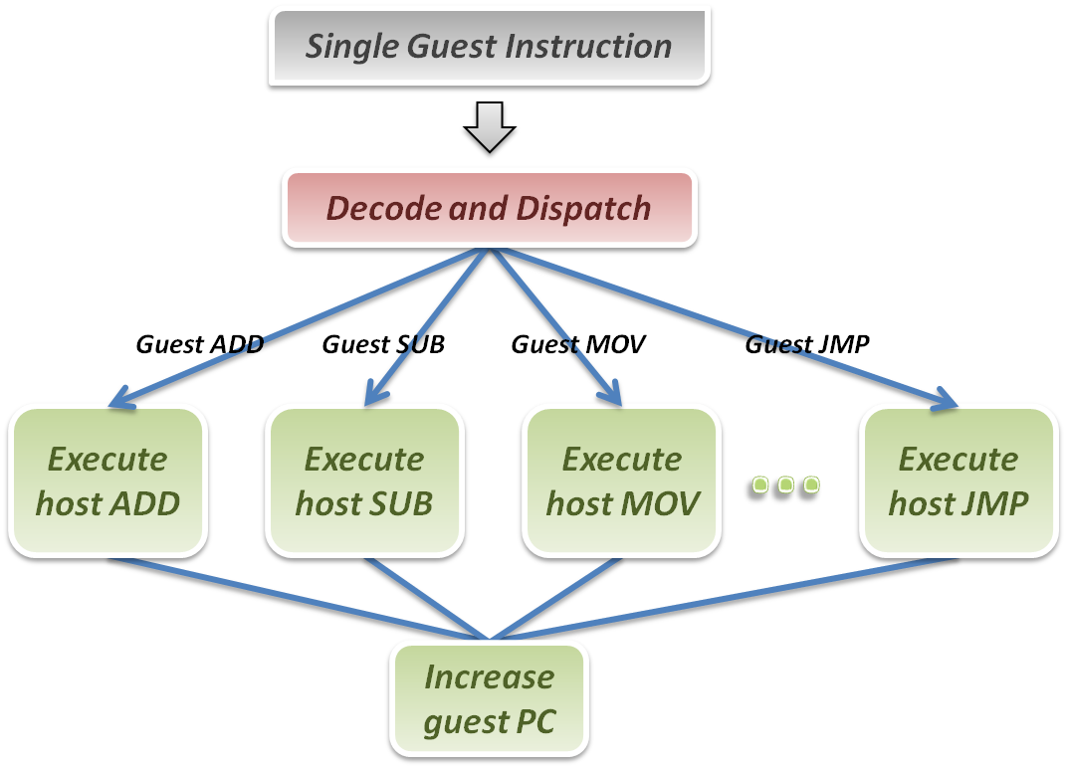
Interpretation (2)
Interpreter

Slide 14
Binary Translation
A technique to optimize binary code blocks, and translate binaries from guest ISA to host ISA
Static approach vs. Dynamic approach
Static binary translation
The entire executable file is translated into an executable of the target architecture
This is very difficult to do correctly, since not all the code can be discovered by the translator
Dynamic binary translation
Looks at a short sequence of code, typically on the order of a single basic block, translates it and caches the resulting sequence
Code is only translated as it is discovered and when possible, branch instructions are made to point to already translated and saved code

Slide 15
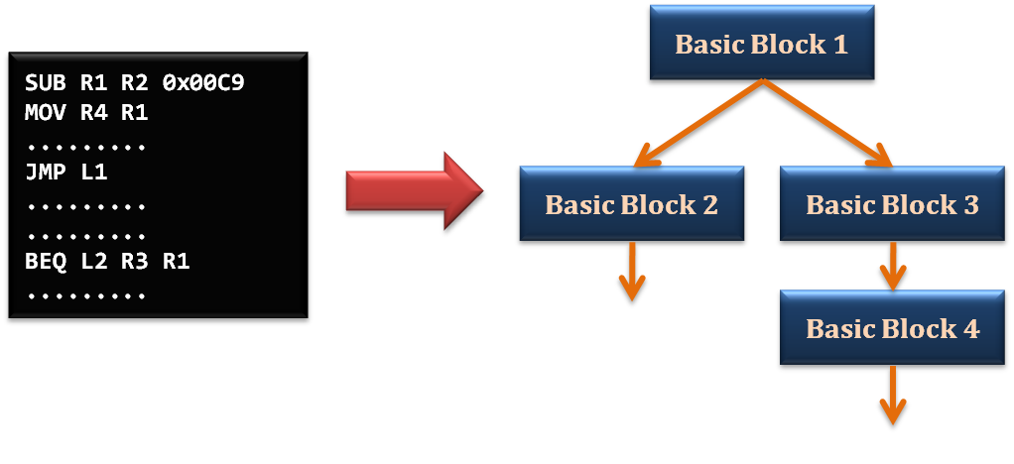
Static Binary Translation (1)
Using the concept of basic block which comes from compiler optimization technique
A basic block is a portion of the code within a program with certain desirable properties that make it highly amenable to analysis
A basic block has only one entry point, meaning no code within it is the destination of a jump instruction anywhere in the program
A basic block has only one exit point, meaning only the last instruction can cause the program to begin executing code in a different basic block

Slide 16
Static Binary Translation (2)
Static binary translation flow :
Fetch one block of guest instructions from guest memory image.
Decode and dispatch each instruction to the corresponding translation unit.
Translate guest instruction to host instructions.
Write the translated host instructions to code cache.
Execute the translated host instruction block in code cache.

Slide 17
Static Binary Translation (3)
Pros & Cons
Pros
Emulator can reuse the translated host code
Emulator can apply more optimization when translating guest blocks
Cons
Implementation complexity will increase

Slide 18
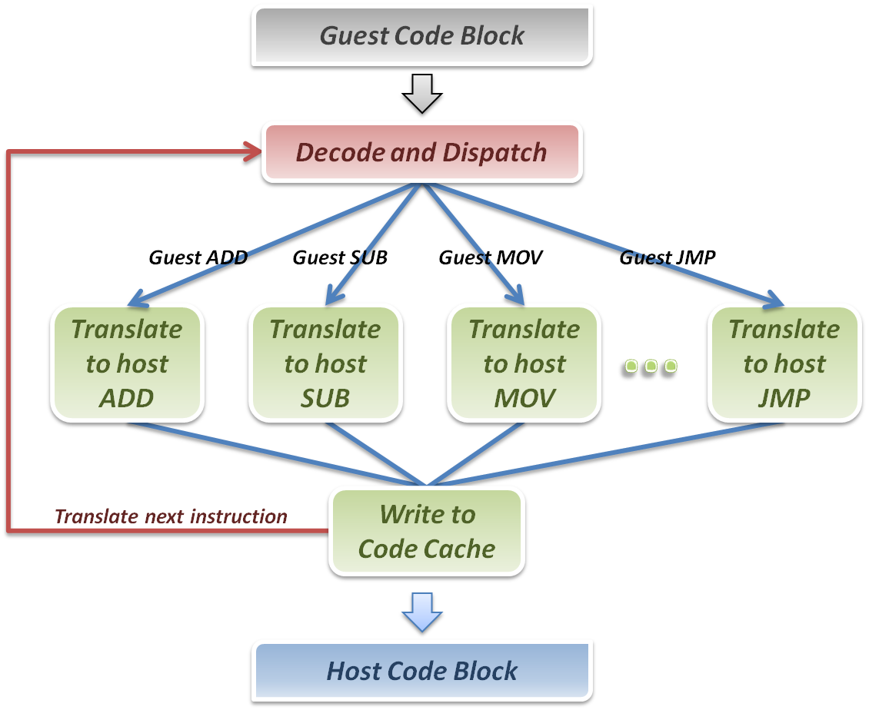
Static Binary Translation (4)
Static Binary Translator

Slide 19
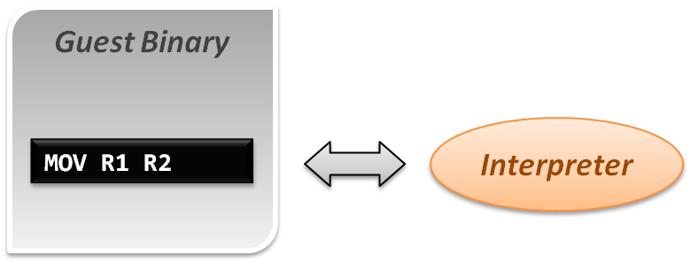
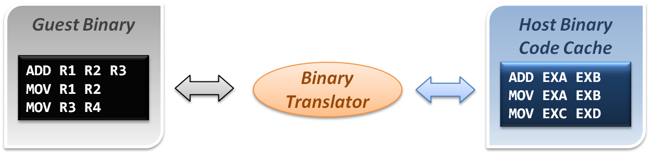
Comparison
Interpretation implementation
Static binary translation implementation

Slide 20
Dynamic Binary Translation (1)
A hybrid implementation
For the first discovered codes, directly interpret by interpreter and record these codes as discovered
As the guest codes discovered, trigger the binary translation module to translate the guest code blocks to host code blocks, and place them into code cache
When execute the translated block of guest code next time, jump to the code cache and execute the translated host binary code
Pros & Cons
Pros
Transparently implement binary translation.
Cons
Hard to implement.

Slide 21
Dynamic Binary Translation (2)
First time execution, no translated code in code cache.
Miss code cache matching, then directly interpret the guest instruction.
As a code block discovered, trigger the binary translation module.
Translate guest code block to host binary, and place it in the code cache.
Next time execution, run the translated code clock in the code cache.
Binary Translator
Guest Binary
trigger
Host Binary Code Cache
Emulation Manager
hit
exit
return
miss
Interpreter

Slide 22
Design Challenges and Issues

Slide 23
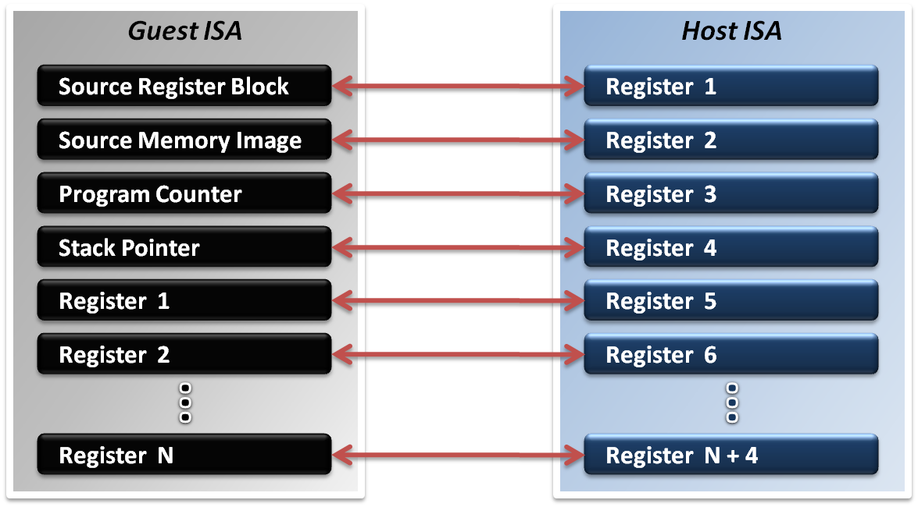
Register Mapping Problem (1)
Why should we map registers ?
Different ISA will define different number of registers
Sometimes guest ISA even require some special purpose register which host ISA does not defined

Slide 24
Register Mapping Problem (2)
If the number of host registers is larger that those of the guest
That will be an easier case for implementation
Directly map one register of guest to one of host, and make use of the rest registers for optimization
Example
Translating RISC binary to x86

Slide 25
Register Mapping Problem (3)
If number of host registers is not enough
That should involve more effort.
Emulator may only map some frequently used guest registers to host, and left the unmapped registers in memory.
Mapping decision will be critical in this case.

Slide 26
Performance Improvement
What introduces the performance hit ?
Control flow problem
Highly frequent context switches between code caches and emulation manager will degrade performance.
Target code optimization
Translate guest code block in instruction-wise (translate one instruction at a time) will miss many optimization opportunities.
Solutions
Translation Chaining
Dynamic Optimization

Slide 27
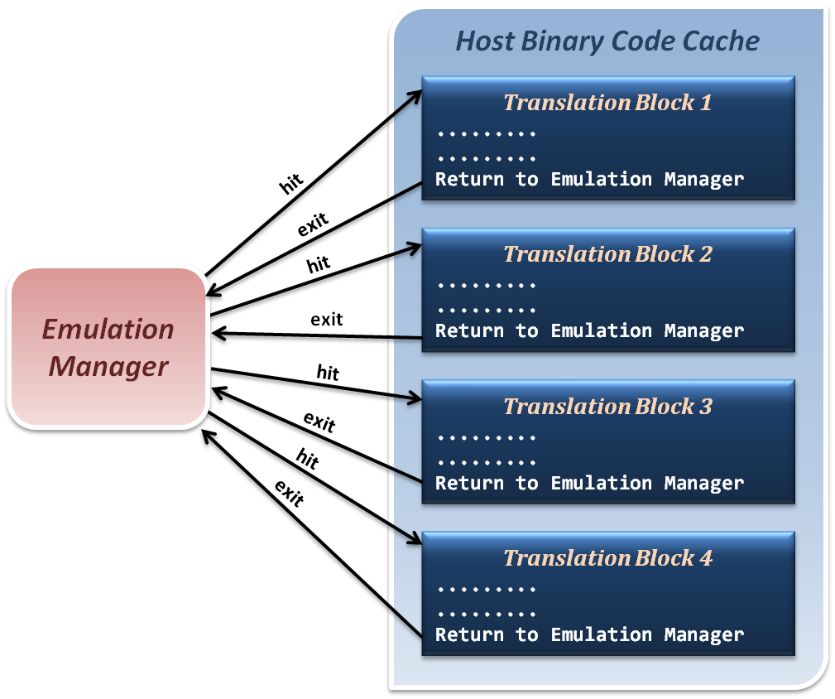
Translation Chaining (1)
Non-optimized control flow between translated blocks and emulation manager
Context Switches

Slide 28
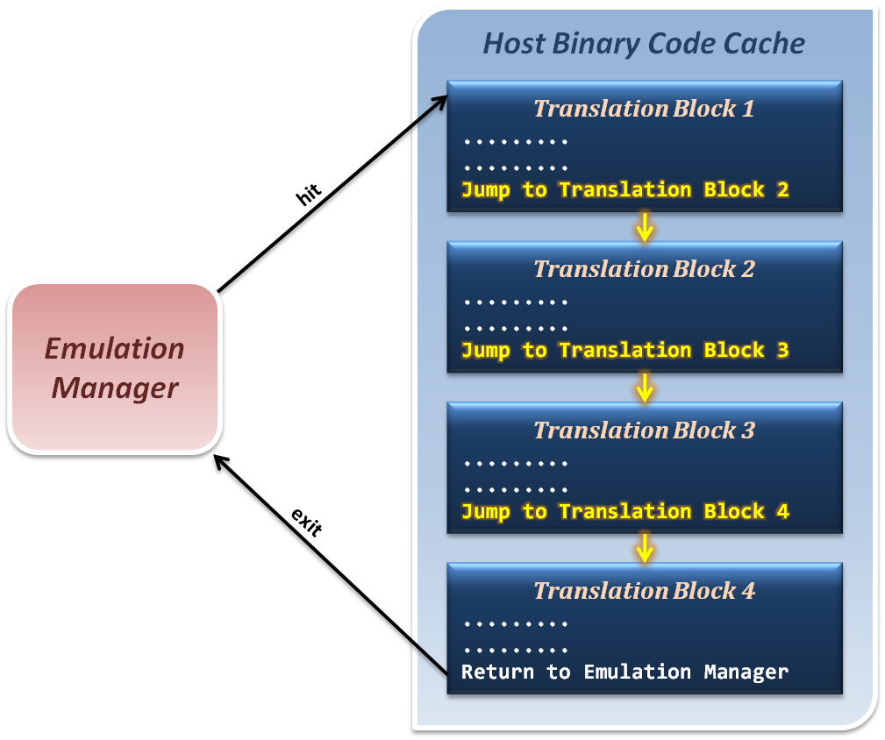
Translation Chaining (2)
Jump from one translation directly to next, which avoid switching back to emulation manager.

Slide 29
Dynamic Optimization (1)
How to optimize binary codes ?
Static optimization (compiling time optimization)
Optimization techniques apply to generate binary code base on the semantic information in source code.
Dynamic optimization (run time optimization)
Optimization techniques apply to generated binary code base on the run time information which relate to program input data.

Slide 30
Dynamic Optimization (2)
Why we use dynamic optimization technique ?
Advantages
It can benefit from dynamic profiling.
It is not constrained by a compilation unit.
It knows the exact execution environment.

Slide 31
Dynamic Optimization (1)
How to implement dynamic optimization
Analysis program behavior in run time
Collect run time profiling information based on the input data and host hardware characteristics
Dynamically translate or modify the binary code by reordering instructions or other techniques
Write back the optimized binary into code cache for next execution

Slide 32
Dynamic Optimization (2)
How to analyze program behavior and profile
Collect statistics about a program as it runs
Branches (taken, not taken)
Jump targets
Data values
Cache misses
Predictability allows these statistics to be used for optimizations to be used in the future
Profiling in a VM differs from traditional profiling used for compiler feedback

Slide 33
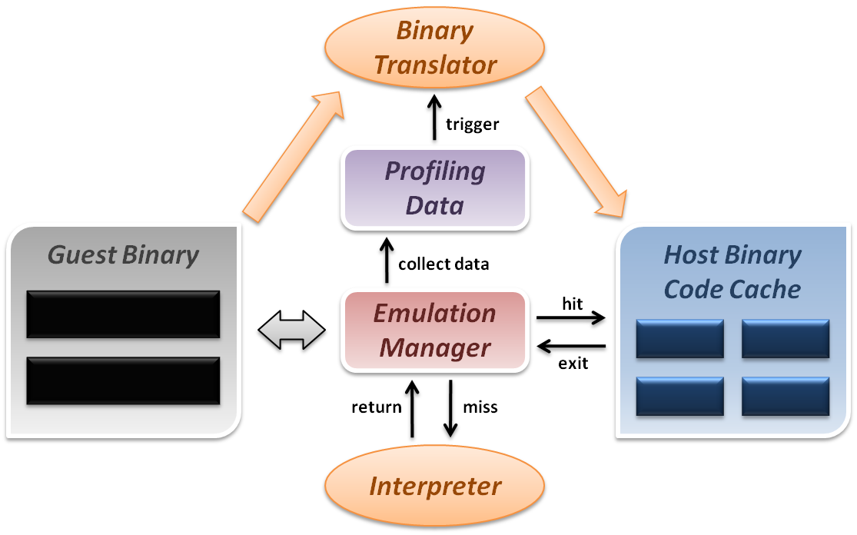
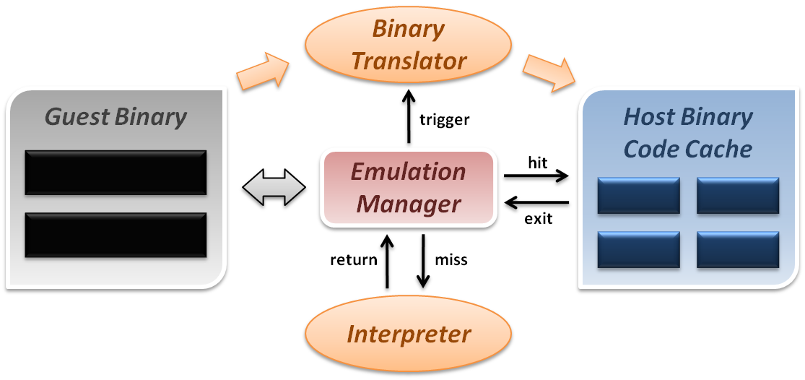
Dynamic Optimization (3)
Dynamic binary translation and optimization

Slide 34
VIRTUALIZATION

Slide 35
System Virtual Machine
System virtual machines are capable of virtualizing a full set of hardware resources, including a processor (or processors), memory and storage resources and peripheral devices.
Constructed at ISA level
Allow multiple OS environments, or support time sharing.
Examples
IBM VM/360
VMware
Xen
KVM
OKL4
Android
Windows Phone
App
App
App
App
App
App
App
App
Linux kernel
Windows Phone 8’s kernel
Virtual Machine Monitor
Hardware

Slide 36
Virtual Machine Monitor: Main Theorem
A virtual machine monitor can be constructed if the set of sensitive instructions is a subset of the set of privileged instructions
Proof shows
Equivalence
by interpreting privileged instructions and executing remaining instructions natively
Resource control
by having all instructions that change resources trap to the VMM
Efficiency
by executing all non-privileged instructions directly on hardware
A key aspect of the theorem is that it is easy to check

Slide 37
Emulation & Virtualization
Emulation seems a good way to implement VMM.
We can run Guest OS above emulator.
Emulator can manage all hardware resource and arrange sharing resource to Guest OS
However, there are rarely people using emulator as VMM.
WHY?
Because emulation is quite SLOW!
It’s not Efficient!
How to let it faster?
Don’t emulate everything. Just emulate some sensitive instruction which will directly access hardware resource.
Execute all non-privileged instructions directly on hardware

Slide 38
full-virtualization & Para-virtualization

Slide 39
Full-Virtualization
Definition
We run the Guest OS without modified.
The Guest OS doesn’t realize that it is running above VM rather than physical machine.
Pro
User can use any OS what he/she wants to install as Guest OS
For those OS which is hard to patch (ex: Windows, because it’s hard to get its source code), user can only install them in full-virtualization environment
Con
For non-virtualizable CPU, running Guest OS without patched critical instruction need use Dynamic Binary Translation in the hypervisor. It costs a lot.
Even for the virtualizable or hardware assistant CPU, running an OS which doesn’t find out its in VM rather in physical machine is still lots of computing resource. Using patched guest OS can avoid these resource wasting. And using full-virtualization environment cannot gain the performance optimization.

Slide 40
Para-Virtualization
Definition
Run the Guest OS which is patched for virtualization.
The Guest OS realizes that it is running above VM rather than physical machine.
Pro
For non-virtualizable CPU, running Guest OS with patched critical instruction can reduce lots of work for hypervisor. Let guest OS run faster.
Even for the virtualizable or hardware assistant CPU, running an OS which doesn’t find out its in VM rather in physical machine is still lots of computing resource. Using patched guest OS can avoid these resource wasting.
Con
User cannot use any OS what he/she wants to install as Guest OS
For those OS which is hard to patch(ex: Windows, because it’s hard to get its source code), user cannot install them as guest OS.

Slide 41
categories of virtual machine

Slide 42
Several Types of VMM
According to the category from Popek and Goldberg in 1974, virtual machine monitor can be separate into two major type which are majorly category from where the hypervisor is.
Type 1
a.k.a. “Bare-metal VMM”
Type 2
a.k.a. “Hosted VMM”

Slide 43
Type-1 : bare-metal VMM

Slide 44
Bare-Metal VMM
VMM is responsible for scheduling and managing the allocation of HW resources
Examples
Xen
Hyper-V
VMware workstation
Android
Windows Phone
App
App
App
App
App
App
App
App
Linux kernel
Windows Phone 8’s kernel
Bare-Metal VMM
Hardware: ARM Cortex-A15 and beyond

Slide 45
Type-2 : hosted VMM

Slide 46
Hosted VMM
VMM is built on top of an existing OS
Installation process is similar to the installation of an APP
Let the host OS to provide device drivers and other low-level services
Can patch privileged instructions to VMM calls (traps), or using DBT techniques
Example:
VMware player
KVM
Parallels
Android
App
App
App
App
Windows
Windows
App
App
App
App
App
App
App
App
Windows 8’s kernel
Windows 8’s kernel
Hosted VMM
Linux kernel
Hardware: ARM Cortex-A15 and beyond

Slide 47
Comparison with Native and Hosted VMs
Virtual
Virtual
Machine
Machine
Applications
Virtual
Non-privileged
Machine
modes
VMM
VMM
OS
VMM
Host OS
Host OS
Privileged
Mode
Hardware
Hardware
Hardware
Hardware
Traditional
Native
User-mode
Dual-mode
uniprocessor
VM system
Hosted
Hosted
system
VM system
VM system

